Slide 1
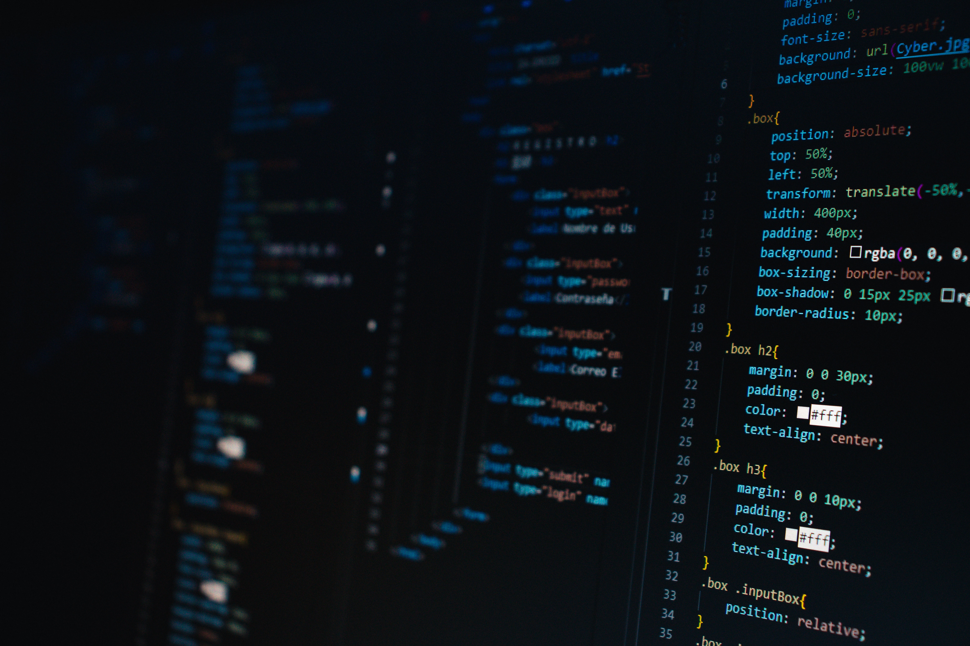
Security+ Chapter 3
Malicious Code
Author: Justin McAfee
@IaintShootinMis
Twitter|Github

Slide 2

Who Am I?
- Former PSYOP Soldier
- Current Incident Response Analyst for a global food and beverage supplier
- Dad, husband and National Park enthusiast

Slide 3
What’s In It?
- Malware
- Malicious Code
- Adversarial AI

Slide 4
Malware Types
- Ransomware
- Trojans
- Worms
- Rootkits
- Backdoors
- Bots
- Keyloggers
- Logicbombs
- Viruses
- Fileless Viruses
- Spyware
- Potentially Unwanted Programs (PUPs)

Slide 5
Malware
- Short for Malicious Software
- Overarching term used to describe a large number of malicious softwares. (Replaces the common term “virus”)
- Causes harm to systems and devices, networks, and users and/or gather info, provide illicit access, and take actions on an affected system.

Slide 6
Ransomware
- Hijacks a computer and demands a ransom
- May use encryption to lock down a users files
- May accompany pirated software or pornography and threaten to report users to law enforcement
- Effective backups are the only true protection from ransomware
- Some organizations pay ransoms

Slide 7
Trojans
- named after the Trojan Horse
- disguised as legitimate software and requires user interaction
- RATs (Remote Access Trojans) are a subset
- Used to take control of a system to perform additional behavior
- Not to be confused with Remote Access Tools, legitimate software used to provide remote assistance

Slide 8
Worms
- doesn’t require user interaction
- can spread themselves
- often spreads by network connections, file shares, email attachments, etc...
- self install without user interaction
- Extremely dangerous to work with

Slide 9
Rootkits
- Designed to allow attackers backdoor access
- Puts malicious code between the user and the computer to modify user inputs, computer outputs, and hide its traces
- Extremely difficult to diagnose using the infected system
- Removal may not be possible, or extremely costly, backups are a great defense

Slide 10
Backdoors
- access that bypasses normal authentication and authorization
- allows access to systems, devices, or applications
- Trojans and Rootkits often include backdoors
- May be intentionally included by hardware/software manufacturers during development, then left for deployment
- Often discovered by attackers

Slide 11
Bots & Botnets
- remotely controlled systems or devices with a malware infection
- used in concert to perform addition compromises and infections, relay spam, and provide infrastructure for denial-of-service attacks
- Communicate over C2 ( Command and Control) channels

Slide 12
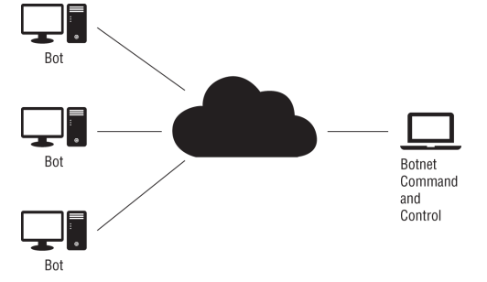
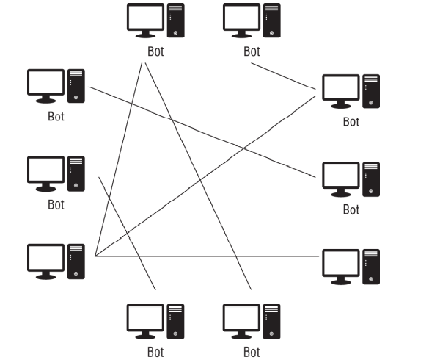
2 Different Flavors
Client → Server
Peer-to-Peer

Slide 13
KeyLoggers
- software that can capture all or specific key presses
- may also consume mouse movements, touch screen taps, or payment card info
*Not on the Exam*: But hardware keyloggers
exist and are very inexpensive

Slide 14
Logic Bombs
- require a specific set of circumstances to activate, a date, a specific input, etc…
- very rare
- not independent programs, rather malicious content within a program
- hard if not impossible to detect without reviewing original code

Slide 15
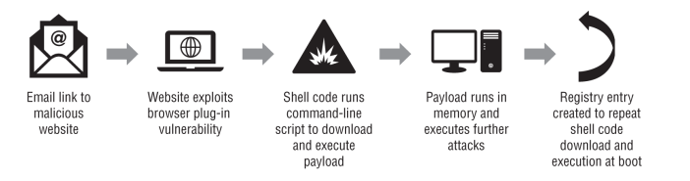
Fileless Viruses
- like normal malware, but never get saved to disk
- always reside in memory
- persist in future re-infections through registry keys that re-infect machines

Slide 16
Spyware
- designed to obtain location data, message contents, browsing habits, spending habits, camera access, etc…
- may be used against a company, enterprise, government, individual users, or a romantic partner
- A subset of this software type is Stalkerware, often installed by individuals in unhealthy or abusive relationships (Life360?)

Slide 17
Potentially Unwanted Programs
- adware, browser plugins, web tracking, bundled programs
- not necessarily malicious, but user is likely unaware of installation
- Often not malicious, just annoying or intrusive

Slide 18
Malicious Code
- Scripts/macros vs compiled code
- May use interpreted languages
- Powershell (Win)
- Visual Basic (Win)
- Python (Win/Linux/macOS)
- Bash (Linux/macOS)
- Also includes “macros”

Slide 19
AI/ML and Adversarial AI
- AI and Machine Learning are “trained” by being given certain sets of data and programmed to recognize them
- May be unintentionally corrupted by unaware installers/users
- May be intentionally corrupted by threat actors

Slide 20
Check on Learning
- software that collects key strokes and mouse movements
- malicious software that only exists in memory and reinfects after removal or reboot
- software that demands users pay for access to files or to prevent embarrassing consequences

